Slide 1
Unit 5:
Digital Innovation and Trends

Slide 2
Introduction to Lecturer
Digital Marketing Manager, Javra Software B.V – Netherlands, Portugal, Nepal
Certified Digital Marketing Trainer, Upskills Nepal
Masters in Computer Application (MCA), Kantipur City College (PU)
MBA Faculty Lecturer, Kasthamandap College of Management(PU)
MBA Faculty Lecturer, SANN International College(PU)
BBA Faculty Lecturer, Cosmos College of Management and Technology(PU)
Nutan Regmi [MBA, Bsc. Computer Science & IT]

Slide 3
The Contemporary Digital Revolution
Defining the Digital Revolution
Historical Context: The Digital Revolution, also known as the Third Industrial Revolution, began in the late 20th century, marked by the transition from analog to digital technologies.
Key Technological Advancements:
Internet: The foundation for global communication and information sharing.
Mobile Technology: Smartphones and tablets enabling on-the-go access.
Cloud Computing: Scalable and accessible data storage and processing.
Artificial Intelligence (AI): Transforming industries through automation and insights.
Impact: The shift has revolutionized how we communicate, conduct business, and access information.

Slide 4
Impact on Business and Society
Business Models: E-commerce, digital marketing, and remote work have become mainstream. Traditional business models are forced to adapt or risk obsolescence.
Consumer Behavior: Consumers now expect personalized experiences, instant access to information, and seamless online transactions.
Social Interactions: Social media and online communities have transformed how people connect, share information, and form relationships.
Data-Driven Decision Making: Data analytics tools help organizations understand customer behavior, optimize marketing efforts, and make informed strategic decisions.

Slide 5
Case Studies
Amazon: Transformed retail through e-commerce, cloud computing (AWS), and AI-driven recommendations. Its customer-centric approach and continuous innovation have made it a dominant player.
Netflix: Disrupted the entertainment industry by offering streaming services, personalized recommendations, and original content. It adapted to changing consumer preferences, leading to its global success.
Uber: Revolutionized transportation through mobile apps, GPS technology, and data analytics. It created a new business model that connected drivers and riders efficiently.

Slide 6
Digital transformation
Definition: Digital transformation is the integration of digital technology into all areas of a business, fundamentally changing how it operates and delivers value to customers.
Beyond Technology: It's not just about implementing new technologies; it involves cultural changes, process optimization, and a focus on customer experience.
Key Aspects:
Organizational Culture: Fostering innovation, collaboration, and adaptability.
Process Changes: Streamlining operations, automating tasks, and improving efficiency.
Customer Experience: Enhancing customer satisfaction, loyalty, and engagement through digital touchpoints.

Slide 7
Key Elements of a Digital Transformation Framework
Vision and Strategy:
Setting Clear Goals: Defining specific, measurable, achievable, relevant, and time-bound (SMART) objectives.
Strategic Alignment: Ensuring digital initiatives align with overall business goals.
Example: A retail company sets a goal to increase online sales by 30% within the next year through a revamped e-commerce platform and targeted digital marketing campaigns.
Leadership:
Driving Change: Leaders must champion digital initiatives, inspire employees, and create a culture of innovation.
Cross-Functional Collaboration: Encouraging collaboration between IT, marketing, sales, and other departments.
Example: A CEO actively promotes digital transformation by investing in training programs, establishing cross-functional teams, and communicating the importance of digital initiatives to all employees.

Slide 8
Data and Analytics:
Data-Driven Insights: Using data to understand customer behavior, market trends, and business performance.
Analytics Tools: Implementing tools like Google Analytics, CRM systems, and data visualization software.
Example: An e-commerce company uses customer purchase history and browsing behavior to personalize product recommendations, optimize website layout, and target marketing campaigns more effectively.

Slide 9
Key Elements of a Digital Transformation Framework
Technology:
Choosing the Right Technologies: Selecting technologies that align with business goals and provide a competitive advantage.
Cloud Computing: Utilizing cloud services for scalability, cost-efficiency, and flexibility.
Artificial Intelligence (AI): Implementing AI for automation, personalization, and predictive analytics.
Internet of Things (IoT): Connecting devices and collecting data for improved operations and customer experiences.
Example: A manufacturing company adopts IoT sensors to monitor equipment performance, predict maintenance needs, and optimize production processes.

Slide 10
2. Customer Experience:
Improving the Customer Journey: Enhancing all touchpoints of the customer journey, from awareness to purchase to post-sales support.
Personalization: Tailoring experiences based on customer preferences, behaviors, and demographics.
Mobile-First Approach: Optimizing digital channels for mobile devices to cater to on-the-go customers.
Example: A bank develops a mobile app with personalized financial advice, easy account management, and seamless customer support to enhance the overall banking experience.

Slide 11
3. Agile Processes:
Implementing Agile Methodologies: Using agile approaches like Scrum or Kanban to manage projects, iterate quickly, and adapt to changing requirements.
Continuous Improvement: Fostering a culture of experimentation, learning, and continuous improvement.
Example: A software development company adopts Scrum to manage its development projects, allowing for frequent feedback, rapid iteration, and faster time-to-market.

Slide 12
Frameworks and Models
McKinsey 7-S Framework: Focuses on the alignment of seven key elements: strategy, structure, systems, shared values, skills, style, and staff.
Application: Helps organizations assess their readiness for digital transformation and identify areas for improvement.

Slide 13
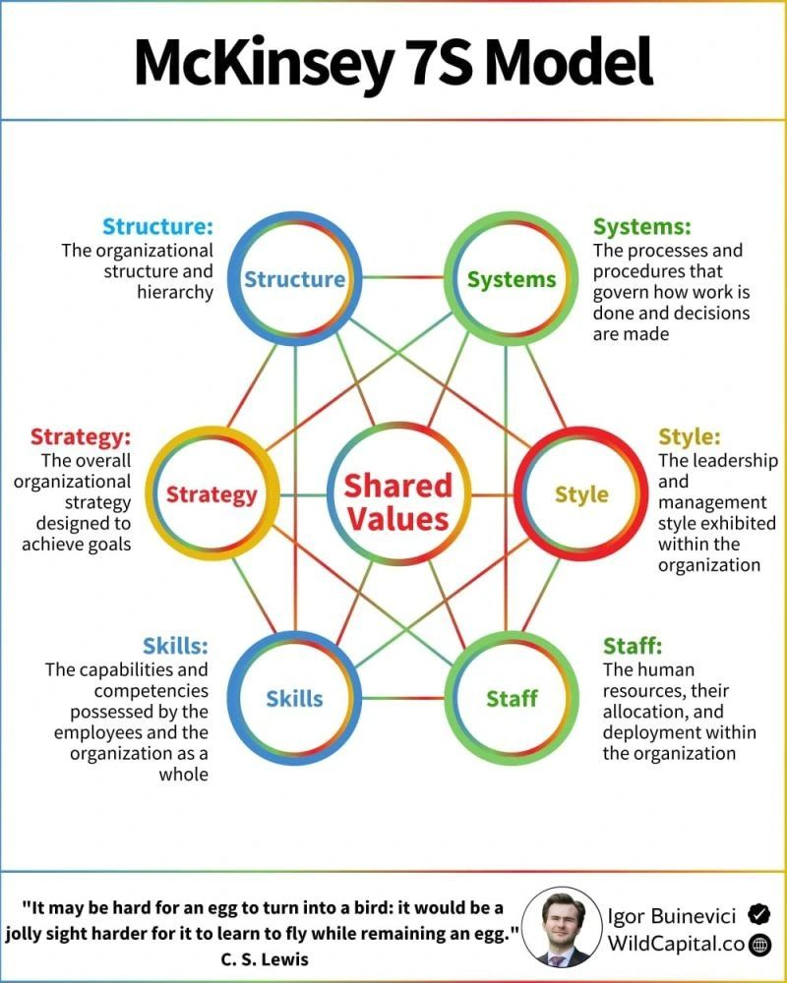

Slide 14
Security and Privatization Issues in Digital Marketing
Data Privacy and Security
GDPR (General Data Protection Regulation): A European Union regulation that sets strict rules for data processing and privacy.
Key Principles: Consent, transparency, data minimization, and the right to be forgotten.
CCPA (California Consumer Privacy Act): A California law that gives consumers more control over their personal information.
Key Rights: The right to know, the right to delete, the right to opt-out, and the right to non-discrimination.
Importance of Data Protection: Protecting customer data builds trust, reduces the risk of data breaches, and ensures compliance with regulations.
User Consent: Obtaining explicit consent from users before collecting and processing their data.

Slide 15
Cybersecurity Threats
Phishing: Deceptive attempts to obtain sensitive information through fake emails, websites, or messages.
Malware: Malicious software designed to harm or disrupt computer systems.
Ransomware: A type of malware that encrypts data and demands a ransom for its release.
Impact on Digital Marketing: Cybersecurity threats can compromise customer data, disrupt marketing campaigns, and damage brand reputation.

Slide 16
Brand Reputation and Crisis Management
Handling Security Breaches: Responding quickly and transparently to security breaches to minimize damage to brand reputation.
Privacy Scandals: Addressing privacy concerns and taking corrective actions to regain customer trust.
Crisis Communication: Developing a crisis communication plan to manage negative publicity and communicate effectively with stakeholders.

Slide 17
Understanding Trends in Digital Marketing - Nepal & India
Internet Penetration: Around 40-50% of the population has access to the internet.
Social Media Usage: Facebook, Instagram, and YouTube are the most popular platforms.
E-commerce Adoption: E-commerce is growing but still faces challenges due to limited online payment options and logistical issues.
Unique Market Characteristics: High mobile penetration, growing youth population, and increasing demand for digital content.
Challenges: Limited digital literacy, infrastructure limitations, and regulatory constraints.

Slide 18
Digital Landscape in India
Internet Penetration: Over 50% of the population has access to the internet, making it one of the largest online markets in the world.
Social Media Usage: High engagement on platforms like Facebook, Instagram, WhatsApp, and YouTube.
E-commerce Adoption: Booming e-commerce market driven by increasing internet penetration, mobile usage, and digital payment options.
Unique Market Characteristics: Diverse linguistic and cultural landscape, rapid urbanization, and a large middle-class population.
Challenges: Digital divide between urban and rural areas, data privacy concerns, and cybersecurity threats.

Slide 19
Understanding Trends in Digital Marketing - Global Context
Global Digital Trends
Artificial Intelligence (AI): AI-powered tools for personalization, automation, and data analysis.
Extended Reality (XR): AR and VR technologies for immersive experiences and virtual interactions.
Voice Search: Growing importance of voice search and voice commerce.
Social Commerce: Social media platforms as key sales channels.
Data Privacy: Increased emphasis on data privacy and ethical marketing practices.

Slide 20
Cross-Cultural Marketing
Language: Localizing content and marketing materials for different languages.
Cultural Sensitivity: Understanding and respecting cultural values, traditions, and customs.
Imagery: Using culturally relevant images and visuals in advertising campaigns.
Communication Style: Adapting communication style to resonate with local audiences.

Slide 21
Case Studies
McDonald’s: Successfully localized its menu and marketing campaigns in different countries to cater to local tastes and preferences.
Coca-Cola: Implemented culturally relevant advertising campaigns that resonated with diverse global audiences.
Nike: Tailored its marketing messages and product offerings to align with local sports and cultural trends.

Slide 22
Online Communities
What are Online Communities?
Definition: Online communities are groups of people who interact with each other over the internet, sharing common interests, goals, or values.
Types:
Forums: Online discussion boards where users can post questions, share information, and engage in conversations.
Social Media Groups: Groups on platforms like Facebook, LinkedIn, and Reddit where users can connect and discuss specific topics.
Brand Communities: Communities created by brands to connect with customers, build loyalty, and gather feedback.
Importance: Online communities provide a platform for brands to engage with customers, gather feedback, and build relationships.

Slide 23
5Ds of Digital Marketing
Digital Devices: Smartphones, laptops, tablets, smart TVs, gaming consoles - any device used to access digital content.
Digital Platforms: Social media networks like Facebook, Instagram, Twitter, LinkedIn, search engines like Google, and other online platforms where users engage with content.
Digital Media: Various channels used to deliver marketing messages, including website content, email marketing, social media posts, online advertising, videos, and more.
Digital Data: Information gathered from user interactions on digital platforms, such as website traffic, demographics, behavior patterns, and purchase history, used for analysis and insights.
Digital Technology: The tools and software used to create, manage, and deliver digital marketing campaigns, including website builders, analytics platforms, email marketing services, and social media management tools.

